Slide 1

Welcome to Open Enrollment
Your introduction to financial health benefit accounts

Slide 2
Agenda
Introduction to Optum Financial | 3
Health savings account (HSA) | 5–10
Flexible savings account (FSA) | 11–14
Health reimbursement account (HRA) | 15–17
Commuter benefit accounts | 18–21
Health account resources | 22–23
Q&A | 24

Slide 3




Open enrollment is your once-a-year chance to choose a health plan that meets your needs and allows you to save income tax-free. Optum Financial® helps you reduce health care costs, so you can spend more on the things you love, offering:
Ways to save
Easy payments
Choose accounts to help you with
life’s most important expenses:
HSAs, FSAs, HRAs, etc.
Lifestyle spending accounts
Commuter and parking benefits
Payment cards that can be used most anywhere and digital wallet capabilities (offered for some account types)
Easy-to-use technology
Hands-on resources
Innovative tools, including an app, help you use, manage and maximize your accounts
Information at your fingertips through engaging videos, courses, flyers, webinars and more

Slide 4
Let’s look at the range of financial health benefit accounts that fit your ever-evolving needs and help you save income tax-free along the way.

Slide 5

Health savings account
(HSA)

Slide 6
You’re eligible for an HSA if you:
Aren’t covered by any other health plan that is not a high-deductible health plan (HDHP)
Are not enrolled in Medicare, TRICARE or TRICARE for Life
Haven’t received Veterans Affairs (VA) benefits within the past
3 months, except for preventive care; if you have a disability
rating from the VA, this exclusion doesn’t apply
Can’t be claimed as a dependent on someone else’s tax return
Don’t have a health care flexible spending account (FSA) or
health reimbursement arrangement (HRA). Note: Alternative plan
designs, such as a limited-purpose FSA or HRA, might be permitted
Other restrictions and exceptions may also apply. We recommend
that you consult a tax, legal or financial advisor to discuss your
personal circumstances.
What’s an HSA?
A health savings account (HSA) helps you save smarter through all stages
of life. It lets you use income tax-free dollars to pay for qualified medical, dental and vision expenses.
Your HSA dollars are yours to keep. Balances carry over from year-to-year, to new jobs and even into retirement.

Slide 7





How an HSA helps
you save money
HSAs are triple tax advantaged accounts, helping
you save, earn and spend income tax-free:
An example of savings potential
Here’s how much Jai, age 27, could save with her HSA
Because she hasn’t had many medical expenses, Jai decided not to touch her
HSA balance during her first year. Once
she turns 40, she begins using $500
each year to cover her health costs.
Contribute income tax-free money to your account
(up to IRS limits) and adjust at any time during the year.
Monthly contribution | $100
Balance at the end of the first year | $1,200
Balance at age 65 | $33,800
Annual income tax savings | $356*
Grow your savings with income tax-free interest and investment growth
Spend your HSA dollars on thousands of qualified medical expenses, like glasses, prescription refills
and doctor visits — all income tax-free
Smart tip: Go to optum.com/library
for calculator tools to help determine
the right contribution amount for you.
*Assuming 22% federal income tax and 7.65% FICA. Results and amount will vary depending on your particular circumstances.

Slide 8

Contribute
Things to consider when choosing
your contribution amount:
Do you have any ongoing prescriptions?
Do you have any planned procedures
or surgeries?
Is someone in your family getting braces?
How much is your health plan deductible?
Are you considering starting a family?
When do you plan to retire?
Health savings account contribution summary
IRS 2025 contribution limits | Individual coverage | Family coverage
Maximum HSA contribution level | $4,300 | $8,550
Minimum deductible for qualifying high deductible health plan (HDHP) | $1,650 | $3,300
Maximum out-of-pocket expenses for HDHP | $8,300 | $16,600
Curious how much you’re able to contribute?
View this year’s contribution limits at optumfinancial.com.

Slide 9

Grow: Investing in your HSA
Once you reach the investment threshold, there are options available for every type of investor:
1. Mutual funds – if you’d like to choose from a preselected
list of funds
A diverse variety of mutual funds
High Morningstar ratings
Low expense ratios
2. Digitally managed investments – if you’re short on time or
need help
Online investment support from Betterment
Brief questionnaire on goals, risk profile
Low-cost exchange traded funds (ETFs)
Auto-deposits and automated rebalancing
An example of
savings potential
Here’s how early
investment can pay off
Let’s say you contribute $3,000/year to your HSA until retirement. Assuming you use $1,500/year for medical expenses, earn 7% a year in interest and investments, and reinvest all earnings, your savings can really add up. The earlier you start, the more potential you have:
Starting age | HSA value at age 65*
25 | $320,420
35 | $151,613
45 | $65,799
55 | $22,176
*Hypothetical example for illustrative purposes only. Amounts will vary depending on your unique circumstances.
Account holders must meet the minimum balance to begin investing, this amount may vary, check your online account or plan documents.
Investments are not FDIC insured, are not bank issued or guaranteed by Optum Financial or its subsidiaries, including Optum Bank, and are subject to risk including fluctuations in value and the possible loss of the principal amount invested.

Slide 10












Spend
Examples of HSA-qualified medical expenses:
Acupuncture
Nursing services
Rx drugs and refills
Chiropractic care
Orthodontia
(non-cosmetic)
Psychiatric care
Use the qualified
medical expense tool
at optum.com/
qualifiedexpenses
to review a full list.
Eye exams,
glasses, contacts
Physical exams
Sunscreen (SPF 15+)
Flu shots
Physical therapy
Wheelchairs, walkers,
crutches and canes

Slide 11

Flexible spending account
(FSA)

Slide 12
What’s an FSA?
A flexible spending account (FSA) gives you tax-advantaged money
up front for your health care needs. It’s like an HSA, but with one
big difference:
If you don’t spend your funds
by the end of your plan year,
you could lose your dollars.
Why consider an FSA?
1
Access your dollars from day one: Your FSA funds are available as soon as your plan year begins, even before you contribute. Deposits are exempt from income tax.
2
Spend tax-advantaged money: Dollars spent on eligible medical expenses are income tax-free, meaning your dollars
are added pre-tax through payroll contributions.
3
Remember to spend it: FSAs can differ by employer. FSAs generally do not allow you to use your funds after a specified date. However, your employer may offer grace periods that extend the time you may use your account, and some offer rollovers of unused funds. Check your employer plan documents to see what your FSA allows.

Slide 13



3 types of FSAs and how to use them
Health care FSA
Limited purpose (LPFSA)
Dependent care (DCFSA)
The health care FSA helps pay for certain medical, dental, vision, prescription drug and eligible over-the-counter expenses:
Offered alongside an HSA, this FSA is used to help pay for dental and vision expenses:
This FSA allows use of pre-tax dollars to pay for eligible dependent care services incurred while you work:
Acupuncture
Anesthesia
Alcoholism treatment
Bandages
Blood pressure monitor
Chiropractic care
Copayments
Contact lenses
Deductibles
Eyeglasses
Eye surgery
First aid kits
Flu shots
Hearing aids
Lab fees
LASIK
Learning disability
treatments
Orthodontia
Dental and vision
coinsurance, deductible
Dental visits
Eye examinations
Prescription eyeglasses
Eye surgery
Invisalign
Lasik
Optometrist
After-school program
Babysitting
Childcare
Nanny
Nursery school
Preschool
Sick childcare
Summer day camp

Slide 14
An example of FSA savings potential
Here’s how you can save by contributing to your FSA
If you earn $55,000/year and contribute $2,000/year to your FSA, you will save $1,408.
 | FSA contribution | No contribution
Annual pay | $55,000 | $55,000
Less pre-tax FSA contribution | ($2,000) | —
Taxable income | $53,000 | $55,000
Less federal income and Social Security taxes* | ($15,715) | ($16,307)
After-tax income | $37,285 | $38,693
That’s
$1,408
in potential income
tax savings
$1,408 savings
*Assuming 22% federal income tax and 7.65% FICA. Results and amount will vary depending on your circumstances.

Slide 15

Health reimbursement arrangement
(HRA)

Slide 16

What’s an HRA?
A health reimbursement arrangement (HRA) is an employer-funded
plan that helps cover health care
costs for eligible expenses.
You can use HRA funds to pay for any qualified medical expense
for you, your spouse or your eligible dependents.
Important things to know:
Allowed with most types of health plans
Funds are not taxable to employees
Funds can be used without having to submit
paper claim forms
Employers can choose to have unused funds
roll over from year to year

Slide 17
How does an HRA work?
Your employer funds your account and determines:
What’s eligible with an HRA?
Some qualified health care expenses include:
1
The annual contribution amount
Acupuncture
Chiropractic care
Eye exams, glasses
and contacts
Flu shots
Nursing services
Orthodontia
(non-cosmetic)
Physical exams
Physical therapy
Prescription drugs
and refills
Psychiatric care
Sunscreen (SPF 15+)
Wheelchairs, walkers, crutches and canes
2
When funds are available
3
If funds roll over from year to year
You use your account for eligible expenses:
Check your account balance regularly to know how much you have available to spend on eligible expenses.
Pay for eligible expenses using your payment card or by using personal funds and submitting a claim. Or send a payment directly to your provider from your account.

Slide 18

Commuter
benefits

Slide 19

How much you
can contribute:
$315/month for
transit and parking
What are
commuter benefits?
Commuter benefits save you money on your work commute by letting you pay for transit expenses
with pre-tax money.
From subway passes to parking passes, you can go to point A to B with more money in your pockets.
How commuter benefits work:
Use your payment card to pay for transit expenses.
Purchase a transit pass (mailed to you each month).
Receive a voucher to purchase a transit pass.

Slide 20

An example of savings potential
Here’s how you can save on taxes
Let’s say you spend $300/month for commuter expenses, totaling $1,068/year. By contributing that
amount to your non-taxable commuter expense account, you will save $316 in income taxes at the
end of the year.
 | Enrolled in commuter expense account | Not enrolled in commuter expense account
Annual pay | $55,000 | $55,000
Less annual non-taxable commute expense account contribution | ($1,068) | —
Taxable income | $53,932 | $55,000
Less federal income and Social Security taxes* | ($15,991) | ($16,307)
After-tax income | $39,009 | $38,693
That’s $316 back
in your pocket,
just for getting yourself to work
in a commuter-approved
form of transportation.
$316 savings
*Assuming 22% federal income tax and 7.65% FICA. Results and amount will vary depending on your circumstances.

Slide 21

Transit funds
Parking funds
Eligible options:
Buses
Ferries
Trains and subways
Vanpools
How to use:
Payment card
Bus or train passes
Transit vouchers
Vanpool vouchers
Eligible options:
At or near work
Park and ride
How to use:
Cash reimbursement
Direct pay to garages
Payment card
Vouchers

Slide 22

Health account resources

Slide 23


How to access your accounts with Optum Financial*
Online
App
Payment card
Check your balance
Make deposits
Pay bills
Submit receipts
Reimburse yourself
Manage your investment activity
Pay bills, track payment and reimburse yourself
Check your balance
Search for qualified medical expenses
Capture and submit receipts easily deposit funds
Calculate your contributions
Update your beneficiary
Pay the easier way at the doctor’s office, chiropractor or pharmacy
Pay for qualified medical
expenses online
*Features may differ depending on the account you have.

Slide 24
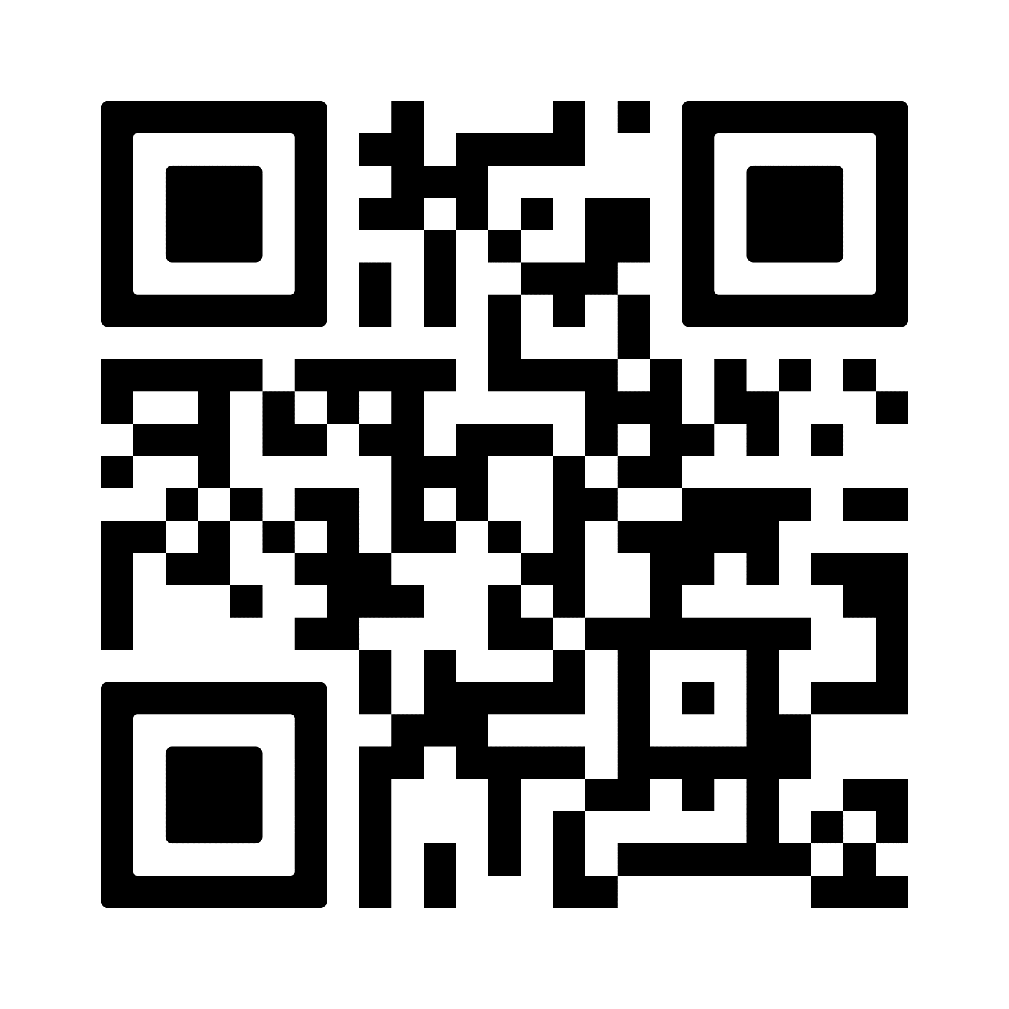
Ready to get started with a financial health benefit account?
What to do next:
Need more information?
1
Enroll in your preferred plan by your employer’s open enrollment deadline
Go to optumfinancial.com
to sign in to your designated
account and view more.
2
Select an account that fits your needs
3
Start saving money all year long

Slide 25
Q&A
optumfinancial.com

Slide 27
Investments are not FDIC insured, are not bank issued or guaranteed by Optum Financial or its subsidiaries, including Optum Bank, and are subject to risk including fluctuations in value and the possible loss of the principal amount invested.
Health savings accounts (HSAs) are individual accounts largely held at Optum Bank®, Member FDIC, and administered by Optum Financial, Inc. or ConnectYourCare, LLC, an IRS-Designated Non-Bank Custodian of HSAs, a subsidiary of Optum Financial, Inc. Neither Optum Financial, Inc. nor ConnectYourCare, LLC is a bank or an FDIC insured institution. HSAs are subject to eligibility requirements and restrictions on deposits and withdrawals to avoid IRS penalties. State and/or local taxes may still apply. Fees may reduce earnings on account. Refer
to your HSA account agreement for details.
Flexible spending accounts (FSAs), dependent care assistance programs (DCAPs), health reimbursement arrangements (HRAs), Commuter and Parking Benefits, Tuition Assistance Plans, Adoption Assistance Plans, Surrogacy Assistance Plans, Wellness Benefits, and Lifestyle Accounts (collectively, “Employer-Sponsored Plans”) are administered on behalf of your plan sponsor by Optum Financial, Inc. or ConnectYourCare, LLC and are subject to eligibility and restrictions. EmployerSponsored Plans are not individually owned and amounts available under the Employer-Sponsored Plan are not FDIC insured.
This communication is not intended as legal or tax advice. Consult a legal or tax professional for advice on eligibility, tax treatment and restrictions. Please contact your plan administrator with questions about enrollment or plan restrictions.
© 2024 Optum, Inc. All rights reserved. WF13561946 321333-061524 OHC

